Slide 1
EA/ArgoUML
caAdapter
caCORE SDK
SIW
UML Loader
caCORE SDK
Create/Edit UML Model
Using caCORE SDK?
Perform Object Relational Mapping
Generate API
Success?
Perform Semantic Integration
Load UML Model in caDSR
Success?
Generate API
1
2d, 5a,
6a
2a
2b
2c
3
4
5
6
XMI File
XYZ
Product/Tool
Process Flow
XMI File Import/Export
N
XMI File Import/Export Step Number

Slide 2
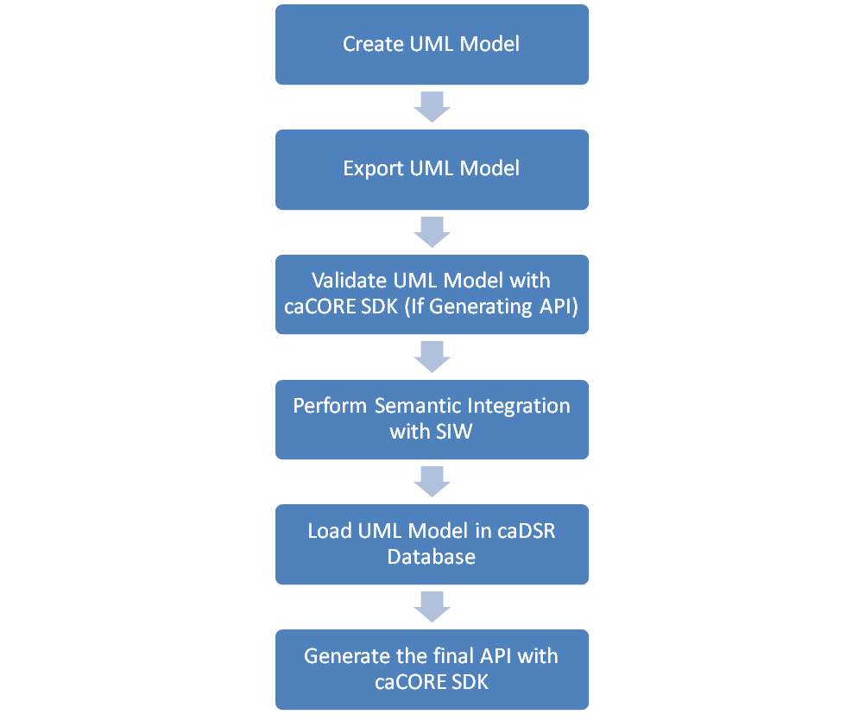

Slide 3
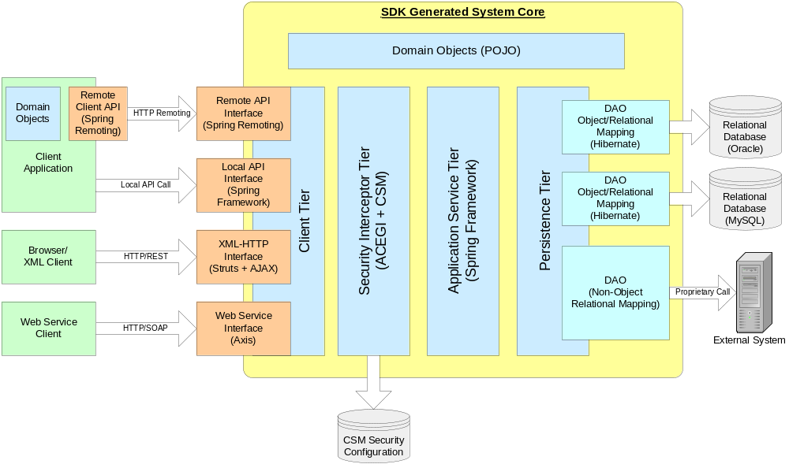
SDK Architecture

Slide 4
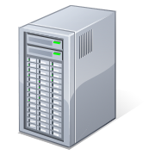
Java Client
SDK Runtime System Core
Domain Objects (beans.jar)
System Configuration
(application-config.xml)
Domain Objects (beans.jar)
System Configuration
(application-config-client.xml)
Relational Database
Client Framework
(client-framework.jar)
Local API Call
Local Java API
(Spring Framework)
ORM DAO
(Hibernate + Spring)
Remote API Call
Remote Java API
(Spring Remoting)
Relational Database
Client Tier
ORM DAO
(Hibernate + Spring)
Security Interception Tier
(ACEGI + CSM)
Application Service Tier
(Spring Framework)
Persistence Tier
Browser/
XML-HTTP Client
Security Filters
(ACEGI)
XML-HTTP Interface
(Struts + AJAX)
HTTP/REST
Non-ORM DAO
Webservice
Client
Web Services
(AXIS)
HTTP/REST
Domain Objects (beans.jar)
CSM
Database

Slide 5
